Slide 1
Mock Up For Location Finder App

Slide 2
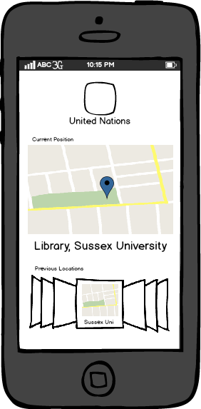
Logo of the app or group
Showing the current position on the map.
Zooming in & out with two finger touch.
Getting the map bigger by double-touch.
Showing the previous locations like a collection.
Looking to the previous locations just scrolling left & right.
Getting into the list view in full screen by double-touch.

Slide 3
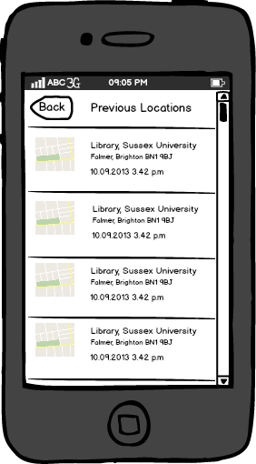
All locations as a list view.
Just by touching, seeing the selected location in full screen.
Going up and down with the scroll.

Slide 4
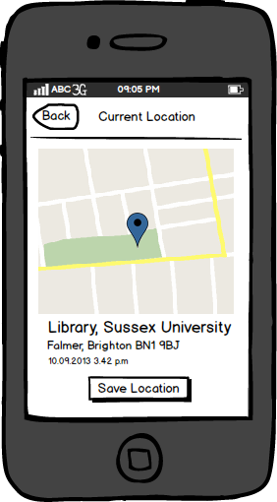
A bigger map for current location.
Zooming in & out with two finger touch.
Having a detailed information about the location.
A save button for saving the current location.

